Slide 1
Recommended Prompts for Microsoft 365 Copilot
Discover what sets Copilot apart
August 2025

Slide 2
Table of Contents
Table of contents
Getting started
Microsoft 365 Copilot
Copilot Chat
Evaluation rubric
Prompt guidance
Getting Started 3
Microsoft 365 Copilot 4
Prompts to try for Microsoft 365 Copilot Chat (work) 4
Prompts to try for Researcher and Analyst agent 5
Prompts to try for Microsoft 365 Copilot in Microsoft 365 apps 6
Free, secure Copilot Chat 7
Prompts to try for Copilot Chat (web) 7
Evaluation rubric 8
Prompt guidance 9
Do’s and don’ts 9
Tips for reasoning over longer documents 10
Discover and share Copilot prompts 10

Slide 3
Getting Started
Table of contents
Getting started
Microsoft 365 Copilot
Copilot Chat
Evaluation rubric
Prompt guidance
This guide is your quick path to harnessing the power of Microsoft 365 Copilot, your AI assistant built for work. Inside, you will discover practical, high-impact prompts to help transform your workflow, highlighting the unique features that set Microsoft 365 Copilot apart from other AI tools.
Explore prompts today to see how
Microsoft 365 Copilot can work for you.
 | Use Work toggle for prompts using your company’s data and Web toggle for general internet-based questions.
 | Evaluate the responses using the ACRUE rubric to ensure quality.
 | Share your favorite prompts and helpful tips to support your team’s success.
 | Provide feedback to your admin or through Copilot’s tools to help improve your experience.
1
2
3
4
Always remember to:
Review and verify AI-generated responses. Copilot uses Large Language Models (LLMs), advanced systems designed to predict and generate text. Occasionally, responses may contain inaccuracies due to the complex nature of LLMs. Always evaluate Copilot’s output and cross-check with trusted sources as needed.
Using the same prompt multiple times may yield different responses. LLMs rely on neural networks, which can introduce some variability. Even with identical prompts, responses might vary slightly each time.
Use Copilot responsibly, ethically, and legally. Avoid employing Copilot for any activities that could harm yourself or others. For more information, see our responsible AI (Artificial Intelligence) principles and standards.

Slide 4

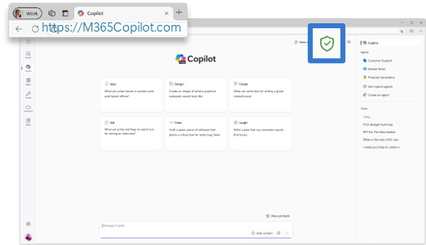
Microsoft 365 Copilot
Table of contents
Getting started
Microsoft 365 Copilot
Copilot Chat
Evaluation rubric
Prompt guidance
Important: If you are not signed in with your work account, Enterprise Data Protection does not apply.
Prompts to try for Microsoft 365 Copilot Chat
To get started, tap Work toggle in the Microsoft 365 Copilot app or visit https://www.M365copilot.com. Then, launch Copilot in your Microsoft 365 apps—on web or desktop—to access the full range of capabilities tailored to your prompt. To unlock even more potential, Try GPT-5.
Scenario | Prompt
Get ready for the day | What are my top priorities today?
Settle meeting conflicts | Recommend how to resolve conflicts on my calendar for tomorrow.
Analyze time allocation | Look at the last 5 work days, identify all the meetings where I was working on [project], add up all the time I spent, breaking it down by how much time I spent with my manager and how much time I spent with my colleagues. Give me a recommendation on how I should better focus my time.
Organize your priorities | Identify all tasks or action items assigned to me in this week’s emails, Teams chats, and meeting notes, and compile them into a checklist with due dates.
Prepare for customer meeting | Create a 360 overview of my customer for an upcoming meeting based on recent emails, meetings, status report, and recent company news. Share recommendations for the meeting and potential questions I should ask.
Develop an interview guide | Create an interview guide for a new Product Marketing role in my team. Draft interview questions in line with company values, my organizations charter, and the job description [upload Interview guide dataset]
Review manager requests | Summarize messages from my manager in the last [timeframe]. For quick reference, bold the title (subject line of emails or the chat/channel name), then follow it with a bulleted list of key points or action items from the content.
Improve professionally | Read through my recent emails and chats and provide a comprehensive analysis of my communication style by identifying my core values, strengths, weaknesses, skills, and areas where I can improve professionally
Create a job description | Build role-specific job descriptions and onboarding plans by analyzing internal performance reviews, department KPIs, and our company values
Focus search on specific files | What's the timeline and status of [project name where files are confidential ]?​
Identify experts | Help me identify colleagues with expertise in [topic]. Summarize their current role, key skills, and how their experience aligns with this topic​

Slide 5
Prompts to try with Researcher and Analyst agents
Table of contents
Getting started
Microsoft 365 Copilot
Copilot Chat
Evaluation rubric
Prompt guidance
Use Research agent for the following prompts:
Develop comprehensive research reports | Based on the internal meeting discussion on [topic], draft a comprehensive research report evaluating the ideas proposed. Incorporate relevant insights from web-based research on [topic] and solutions
Supercharge project management | Create an action item tracker based on all communication channels and other information you can find from the past 7 days. Split it into two categories - actions pending on me, sorted by urgency (and relevance) and actions that I have asked others to do, categorized by if they have a follow up or not, and how long has it been since my request. Recommend who I need to follow up with or send a reminder to.
Create a product launch campaign | Using our internal knowledge base, previous campaign data, and customer insights, create a full launch content package for new product update. Include a customer announcement email, blog post, LinkedIn and Twitter captions, internal team update and help center entry.
Research competitive landscape | Draft a comprehensive research report identifying gaps in the market based on internal discussions with stakeholders in sales, research and development, and support as well as competitive insights and sales data.
Summarize project progress | Draft a project update based on our last meeting in [/meeting] series. Include the KPIs vs. targets, major wins/losses, risks, and competitive moves. Add likely tough questions and suggested answers. Flag any big metric changes
Use Analyst agent for the following prompts:
Analyze new markets | Help me understand the best market to launch a new [product or service] based on fastest growing markets in this [upload dataset]​
Analyze sales performance | Identify our highest and lowest performing stores using [upload dataset]​

Slide 6
Prompts to try for Microsoft 365 Copilot Chat in Microsoft 365 apps
Table of contents
Getting started
Microsoft 365 Copilot
Copilot Chat
Evaluation rubric
Prompt guidance
Scenario | Copilot in… | Prompt
Schedule a meeting | Outlook | Help me schedule a meeting with [/name] this week
Summarize key discussions | Outlook | Write a recap email for my team based on the discussion in this email thread
Stay on top of meetings | Teams meeting | Summarize what’s been discussed so far and list any open questions​ or unresolved items
Jumpstart an email based on a meeting | Teams meeting | Draft a follow-up email based on the action items from today’s meeting [/meeting]
Create precise questions | Teams meeting | Create a list of follow-up questions from the [/meeting] ​
Recap action items | Teams meeting | Recap the meeting before I joined and list any action items where I was mentioned.
Draft a document | Word | Create an intro paragraph with [/file]
Visualize data | Excel | Share the top insights and trends of this data and create a visualization
Summarize data | Excel | a Pivot Table on a new sheet aggregating the following variables: [variable 1], [variable 2], [variable 3]
Collect data | Excel | Find public data about [topic].
Create speaker notes | PowerPoint | Create speaker notes for this slide. Write them in bullets and be sure to add context on our differentiation with this strategy document.

Slide 7
Free, secure Microsoft 365 Copilot Chat
Table of contents
Getting started
Microsoft 365 Copilot
Copilot Chat
Evaluation rubric
Prompt guidance
Important: If you are not signed in with your work account, Enterprise Data Protection does not apply.
Prompts to try for Copilot Chat
To get started, tap Web toggle in the Microsoft 365 Copilot app or visit https://www.M365copilot.com.To unlock even more potential in Copilot, Try GPT-5.
Scenario | Prompt
Strategize next steps | Get me up to speed on the latest plans related to [project]. Help me think through what to do next.
Develop a project plan | Review the attached project plan and give me five substantive ways to make it better; include rationale for your responses and specific text to insert into the plan.
Prepare an executive report | Use the attached spreadsheet with customer feedback to create a polished executive report that helps upper management decide where to prioritize resources in our next cycle. [upload file]
Improve a document draft | We have a draft press release [document]. Find a couple of similar recent announcements on the web and then suggest how to make ours stand out
Gain subject-matter knowledge | Act as a financial compliance analyst, prepare a summary comparing the Dodd-Frank, Basel III, and MiFID II capital adequacy and reporting requirements for banks.
Visualize data quickly | Create a pie chart showing the market share of smartphones in the United States in 2024.
Understand the main point | Recap the findings of this research paper: [upload file]. Highlight the surprising or potentially controversial results, if they exist.
Stand out on socials | Craft an engaging LinkedIn post based on the content of [upload file].
Calculate the ROI | How much value will a $450,000 investment have after 5 years with an 8% return annually? Show your work.
Improve your writing | Rewrite my draft so it sounds more professional and less verbose [upload file].
Code faster | Write a python script to perform binary search.
Generate ideas | Suggest 10 compelling titles for this document: [upload file].
Compare files | Compare the latest [/file name] with its version from [Previous Date] . Summarize what changed, and include any relevant feedback mentioned in emails about those changes
Get writing recommendations | Analyze the text in the following and make suggestions on how to improve it: [insert text]
Visualize a scene | Create an image with the running sneaker standing upright in a modern studio setting. The scene has a clean, minimalist design and the background includes a setting of simple minimalist gradients. [add an image]
¹Image generation and file upload limits apply.
²Every SharePoint site comes with a “ready-made agent”, automatically scoped to the content on that site. To get started, sign in to your SharePoint site with your work account. Open the agent chat pane. Select the dropdown arrow next to the current agent, you will see agents that have been approved for the site. Start asking questions about the site or selected document. Agents that access SharePoint content will be billed based on metered consumption.

Slide 8
Evaluation rubric
Table of contents
Getting started
Microsoft 365 Copilot
Copilot Chat
Evaluation rubric
Prompt guidance
Use this ACRUE rubric as your guide to confidently compare AI tools. It breaks down each dimension with clear definitions and scoring tips, making it simple to evaluate Copilot alongside other solutions.
Evaluation Steps:
Begin by testing the sample prompts.
Examine and confirm the AI-generated answers. Check the sources and ensure the accuracy of your responses.
Try the test prompt on another AI chat platform.
Analyze the variations between the two responses across different aspects.
If you have feedback, use the thumbs up or down buttons, or inform your IT administrator.
Dimension | Definition | 1 Very Poor | 2 Poor | 3 Acceptable | 4 Good | 5 Excellent | Microsoft 365 Copilot | Other
A - Accurate | Are the facts correct? | Contains clear factual errors | Mostly incorrect or misleading | Mostly correct with minor inaccuracies | Correct with minor nuance issues | Fully accurate and trustworthy
C - Comprehensive | Does it cover all important points? | Misses major elements or is overly brief | Covers some points but lacks depth | Covers most relevant points | Covers nearly all key points with good depth | Thorough and complete
R - Relevant | Is it on-topic and aligned with the prompt? | Off-topic or misinterprets the prompt | Partially relevant, some drift | Mostly relevant with slight drift | Clearly relevant with strong alignment | Directly addresses the prompt with precision
U - Useful | Does it help the user achieve their goal? | Unhelpful or confusing | Somewhat helpful but unclear | Moderately helpful | Helpful and mostly actionable | Clearly actionable and insightful
E - Exceptional | Is it better than expected or uniquely valuable? | Generic or uninspired | Slightly better than generic | Meets expectations | Adds value with clarity or creativity | Surpasses expectations with creativity or depth

Slide 9
Prompt guidance
Table of contents
Getting started
Microsoft 365 Copilot
Copilot Chat
Evaluation rubric
Prompt guidance
Context
Goal
Prompts are how you have a conversation with Copilot. Use plain, clear language and provide context like you would with an assistant—prompts are like instructions you provide to Copilot. For the best responses, focus on these four key elements when phrasing your Copilot prompts: context, goal, source, and expectations.
Why do you need it and who is involved?
What response do you want from Copilot.
I work in marketing and focus on competitor research. Give me a concise summary of recent news about [company name]. Focus on web articles from the last 2 months. Provide the answer in two to three paragraphs and use a business tone.
Which information sources or samples should Copilot use?
How should Copilot respond to best meet your expectations?
Source
Expectations
Do’s and don’ts
Most Copilot users generally receive the desired responses. However, as with any AI technology, there are occasions when the answer may not be what you expected. Artificial Intelligence is inherently unpredictable and does not always provide the anticipated outcomes. Get the most out of Copilot and avoid common pitfalls by learning what to do and what not to do when writing prompts:
Do’s
Be clear and specific. Provide specific instructions to Copilot, such as topic, purpose, tone, and required length.
Ask for feedback.
Requesting feedback from Copilot helps it to understand your needs and preferences, and to provide you with more relevant, helpful responses.
Provide details.
Provide Copilot with contextual details to help it generate more accurate, consistent responses. For example, the genre, characters, and plot to a story.
Keep it conversational.
Give feedback to Copilot based on the quality of its responses to help the AI learn and match your preferences.
Write legibly.
Use correct punctuation, capitalization, and grammar when writing prompts, as this will help the AI produce better quality text and responses.
Be polite.
Using kind and respectful language when chatting with Copilot helps foster collaboration and improves the AI's responsiveness and performance.
Give examples.
Use clear and specific keywords or phrases when asking Copilot to write a piece of text for you. This helps it generate more relevant and creative copy.
Check for accuracy.
Occasionally, Copilot may make mistakes. Always check Copilot’s responses for accuracy, grammar, and style, and watch out for irrelevant or inappropriate content.
Be vague. When prompting Copilot, avoid using vague language, and be as clear as possible to receive better-quality responses.
Use slang, jargon, or informal language.
This may cause Copilot to give low-quality, inappropriate or unprofessional responses.
Interrupt or change topics abruptly.
This could disrupt Copilot’s writing process. Always close or finish a task before starting a new one. When starting a new task, write “New task.”
Request inappropriate or unethical content.
Copilot is not responsible for the content or the consequences of your writing. You should respect local laws, rules, and the rights of others.
Give conflicting instructions.
Prompting Copilot to perform a task that includes multiple or conflicting pieces of information in the same request can confuse the AI and result in lower quality responses.
Don’ts

Slide 10
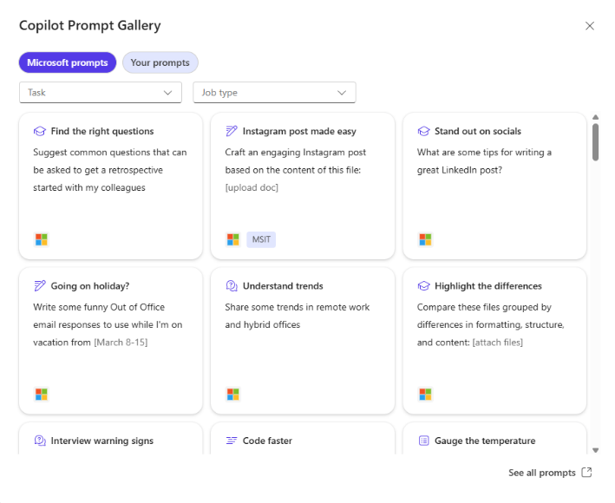
Tips for reasoning over longer documents
Table of contents
Getting started
Microsoft 365 Copilot
Copilot Chat
Evaluation rubric
Prompt guidance
When using Copilot, think of it as having a conversation with a colleague. You wouldn't discuss a whole encyclopedia at once, right? Similarly, keep your document references concise and to the point for the best experience with Copilot.
Here are some ways that you can use longer documents with Copilot:
Break it down: If you have a long document, consider splitting it into smaller documents and providing them to Copilot separately. This way, Copilot can handle each part effectively.
Summarize in parts: For long reports or manuscripts, you can try summarizing them in chunks with Copilot. Today you can do that by copying/pasting chunks into separate documents and summarizing sections separately. This helps Copilot to give you more precise and relevant responses.
Discover and share Copilot prompts
Copilot Prompt Gallery helps you find prompting inspiration so you can take greater advantage of Copilot in your daily work.
Explore the curated selection of Copilot prompts
Save your favorite prompts
Share your favorite prompts with colleagues
Find prompting inspiration from others
Access the Prompt Gallery in Copilot Chat by selecting the box with star icon next to the prompt box. Here, you’ll see suggested Copilot prompts and your saved prompts.

